Slide 1

OSI Model & Its Layers in a Computer Network

Slide 2

What is the OSI Model?
The OSI Model or the Open Systems Interconnection Model is a conceptual framework which describes the functions of a networking system. It is used for the transfer of data over a network which moves through different layers.
Using this model, the functioning of a networking system can be easily explained.

Slide 3
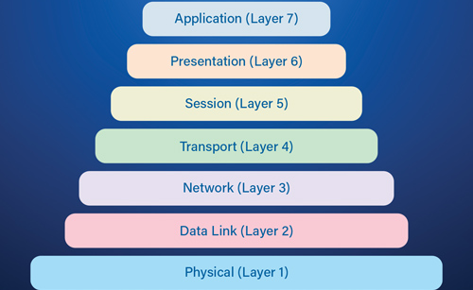

Slide 4
1. Physical Layer
It is the bottom-most or the first layer of the OSI Model
It comprises the raw data which is further transmitted to the higher layers of the structure
Preparing the physical devices in the network and accepting the received data for transmission
The termination of the connection between two nodes of a network also takes place at this stage
This layer converts the digital bits into electrical, radio, or optical signals

Slide 5
2. Data Link Layer
Access to get the data is achieved at this layer
It breaks the input data into frames which makes analysing the data easier
Ensures that the data received is free of any errors
It controls the flow of data in the stipulated time duration and along with a set speed of transmission
The data is sent to the next layer in the form of packets which are then reviewed for further processing

Slide 6
3. Network Layer
It acts as a network controller
Transferring of variable data from one node to another, connected in a network, takes place at this layer
Each node has a specific address and the network layer ensures that the data is sent to its destination address
The data is sent in the form of fragments which are then connected to each other once the processing is done

Slide 7
4. Transport Layer
The delivery of data packets is managed by the transport layer
It manages the flow of data, segmentation and desegmentation and error control
There are five classes of the transport protocol, starting from 0 and continuing till 4 (TP0 to TP4)
Fragmentation and reassembly of data packets occur that this stage

Slide 8
5. Session Layer
The connection between the computers connected in a network is managed at this layer
Establishment, management and termination between the remote and local application takes place here
Authentication and authorization happen at this layer
This layer can also terminate or end any session or transmission which is complete

Slide 9
6. Presentation Layer
The data is converted into the syntax or semantics which an application understands
Before passing on the data any further, the data is formatted at this stage
Functions including compression, encryption, compatible character code set, etc. are also done at this layer of the model
It serves as a data translator for the network

Slide 10
7. Application Layer
The interaction with the user or the user application takes place at this stage
When identifying communication partners, the application layer determines the identity and availability of communication partners for an application with data to transmit

Slide 11

Questions

